Slide 1
Hibernate Annotations

Slide 2
Annotations are used to provide supplement information about a program.
Annotations start with ‘@’.
Annotations do not change action of a compiled program.
Annotations help to associate metadata (information) to the program elements i.e. instance variables, constructors, methods, classes, etc.

Slide 3
Hibernate JPA Annotations - Contents:
Annotation | Package Detail/Import statement
@Entity | import javax.persistence.Entity;
@Table | import javax.persistence.Table;
@Column | import javax.persistence.Column;
@Id | import javax.persistence.Id;
@GeneratedValue | import javax.persistence.GeneratedValue;
@Version | import javax.persistence.Version;
@OrderBy | import javax.persistence.OrderBy;

Slide 4
@Entity
Annotate all your entity beans with @Entity.
@Entity public class Company implements Serializable { ... }
@Table
Specify the database table this Entity maps to using the name attribute of @Table annotation. In the example below, the data will be stored in 'company' table in the database.
@Entity
@Table(name = "company")
public class Company
{
...
}

Slide 5
@Column
Specify the column mapping using @Column annotation.
@Entity
@Table(name = "company")
public class Company
{
@Column(name = "name")
private String name;
...
}

Slide 6
@Id
Annotate the id column using @Id.
@Entity
@Table(name = "company")
public class Company
{
@Id
@Column(name = "id")
private int id;
...
}

Slide 7
@GeneratedValue
Let database generate (auto-increment) the id column.
@Entity
@Table(name = "company")
public class Company
{
@Id
@Column(name = "id")
@GeneratedValue
private int id;
...
}

Slide 8
@Version
Control versioning or concurrency using @Version annotation.
@Entity
@Table(name = "company")
public class Company
{
@Version
@Column(name = "version")
private Date version;
...
}

Slide 9
@OrderBy
Sort your data using @OrderBy annotation. In example below, it will sort all contacts in a company by their firstname in ascending order.
@OrderBy("firstName asc")
private Set contacts;

Slide 10
Employee.java
import javax.persistence.Entity;
import javax.persistence.Id;
import javax.persistence.Table;
@Entity
@Table(name= "emp500")
public class Employee {
@Id
private int id;
private String firstName,lastName;
public int getId() {
return id;
}
public void setId(int id) {
this.id = id; }

Slide 11
public String getFirstName()
{
return firstName;
}
public void setFirstName(String firstName)
{
this.firstName = firstName;
}
public String getLastName()
{
return lastName;
}
public void setLastName(String lastName)
{
this.lastName = lastName;
}
}

Slide 12
Create the Configuration file
To create the configuration file, right click on src/main/java - new - file - specify the file name (e.g. hibernate.cfg.xml) - Finish.
hibernate.cfg.xml
<?xml version="1.0" encoding="UTF-8"?>
<!DOCTYPE hibernate-configuration PUBLIC
"-//Hibernate/Hibernate Configuration DTD 5.3//EN"
"http://www.hibernate.org/dtd/hibernate-configuration-5.3.dtd">

Slide 13
<hibernate-configuration>
<session-factory>
<property name="hbm2ddl.auto">update</property>
<property name="dialect">org.hibernate.dialect.Oracle9Dialect</property>
<property name="connection.url">jdbc:oracle:thin:@localhost:1521:xe</property>
<property name="connection.username">system</property>
<property name="connection.password">jtp</property>
<property name="connection.driver_class">oracle.jdbc.driver.OracleDriver</property>
<mapping class=“.Employee"/>
</session-factory>
</hibernate-configuration>

Slide 14
Hibernate Inheritance
Hibernate provide the three basic inheritance mapping strategies. They are
Table per class hierarchy
Table per subclass
Table per concrete class
1.Table per class hierarchy
Here the table has one row for each field in the entire class hierarchy. You will have plenty of potential null values and you have a discriminator column to contain type information. The table per hierarchy mapping is used as an interface Payment with the implementers CreditCardPayment, CashPayment and ChequePayment.

Slide 15
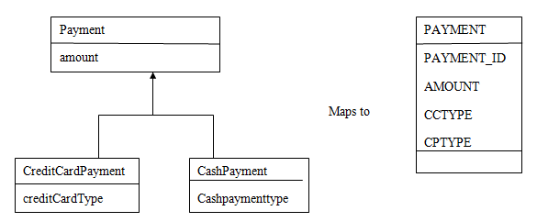

Slide 16
Eg: –
<class table="PAYMENT">
<id column="PAYMENT_ID">
<generator/> </id>
<discriminator column="PAYMENT_TYPE" type="string"/> <property column="AMOUNT"/>
...
<subclass discriminator-value="CREDIT">
<property column="CCTYPE"/>
...
</subclass>
<subclass discriminator-value="CASH">
<property column="CPTYPE"/>
... </subclass>
</class>
Only one table is required for this strategy. The limitation of this strategy is the columns declared by the subclasses, such as CCTYPE cannot have NOT NULL constrains.

Slide 17
Table per subclass
The table type subclass works in two different ways.
1) Table per subclass without discriminator
Here we are using four tables. The three subclass tables have primary key associations to the superclass table so the relational model is actually a one to one association.

Slide 18
Eg: –
<class table="PAYMENT">
<id column="PAYMENT_ID">
<generator/> </id>
<property column="AMOUNT"/> ...
<joined-subclass table="CREDIT_PAYMENT">
<key column="PAYMENT_ID"/>
<property column="CCTYPE"/> ... </joined-subclass>
<joined-subclass table="CASH_PAYMENT">
<key column="PAYMENT_ID"/> ... </joined-subclass>
<joined-subclass table="CHEQUE_PAYMENT">
<key column="PAYMENT_ID"/> ... </joined-subclass>
</class>

Slide 19
Table per subclass with discriminator
Here we are using the discriminator column in the superclass table. If you want to use a discriminator column with the table per subclass type, you can combine the use of <subclass> and <join>.
Eg: –
<class table="PAYMENT">
<id column="PAYMENT_ID">
<generator class="native"/>
</id>
<discriminator column="PAYMENT_TYPE"/>
<property column="AMOUNT"/>
...
<subclass name="CreditCardPayment" discriminator-value="CREDIT">
<join table="CREDIT_PAYMENT">
<key column="PAYMENT_ID"/>
<property column="CCTYPE"/>
…</join></subclass>

Slide 20
<subclass discriminator-value="CASH">
<join table="CASH_PAYMENT">
<key column="PAYMENT_ID"/>
...
</join>
</subclass>
<subclass discriminator-value="CHEQUE">
<join table="CHEQUE_PAYMENT" fetch="select">
<key column="PAYMENT_ID"/>
...
</join>
</subclass>
</class>
The optional fetch=”select” declaration tells Hibernate not to fetch the ChequePayment subclass data using an outer join when querying the superclass.

Slide 21
Table per concrete class
Table per concrete class uses two methods. They are,
1) Table per concrete class without using implicit polymorphism
In this method we are using <union-subclass>. Three tables are involved for the subclasses.
Eg: –
<class name="Payment">
<id column="PAYMENT_ID"> <generator/>
</id>
<property column="AMOUNT"/>
... <union-subclass table="CREDIT_PAYMENT"> <property column="CCTYPE"/> ...
</union-subclass>
<union-subclass table="CASH_PAYMENT"> ... </union-subclass>
<union-subclass table="CHEQUE_PAYMENT"> ... </union-subclass> </class>

Slide 22
Eg: –
<class name="Payment">
<id column="PAYMENT_ID">
<generator/>
</id>
<property column="AMOUNT"/>
...
<union-subclass table="CREDIT_PAYMENT">
<property column="CCTYPE"/>
...
</union-subclass>
<union-subclass table="CASH_PAYMENT">
...
</union-subclass>
<union-subclass table="CHEQUE_PAYMENT">
...
</union-subclass>
</class>

Slide 23
2) Table per concrete class using implicit polymorphism
Notice that the Payment interface is not mentioned explicitly. Also notice that properties of Payment are mapped in each of the subclasses. If you want to avoid duplication, consider using XML entities (for example, [<! ENTITY allproperties SYSTEM “allproperties.xml”>] in the DOCTYPE declaration and & allproperties; in the mapping).

Slide 24
Eg: –
<class name="CreditCardPayment" table="CREDIT_PAYMENT">
<id column="CREDIT_PAYMENT_ID"> <generator/> </id>
<property column="CREDIT_AMOUNT"/> ... </class>
<class table="CASH_PAYMENT">
<id column="CASH_PAYMENT_ID"> <generator/> </id>
<property column="CASH_AMOUNT"/> ... </class>
<class table="CHEQUE_PAYMENT">
<id column="CHEQUE_PAYMENT_ID"> <generator/> </id>
<property column="CHEQUE_AMOUNT"/> ... </class>

Slide 25
For this mapping strategy, a polymorphic association to Payment is usually mapped using <any>.
Eg: –
<any meta-type="string" id-type="long">
<meta-value value="CREDIT" class="CreditCardPayment"/> <meta-value value="CASH" class="CashPayment"/>
<meta-value value="CHEQUE"/>
<column name="PAYMENT_CLASS"/> <column/>
</any>

Slide 26
Or this can be placed

Slide 27
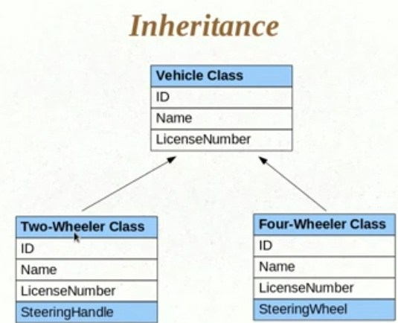

Slide 28
Single Table Strategy
In Single table per subclass, the union of all the properties from the inheritance hierarchy is mapped to one table. As all the data goes in one table, a discriminator is used to differentiate between different type of data.
Advantages of Single Table per class hierarchy
Simplest to implement.
Only one table to deal with.
Performance wise better than all strategies because no joins or sub-selects need to be performed.
Disadvantages:
Most of the column of table are nullable so the NOT NULL constraint cannot be applied.
Tables are not normalized.

Slide 29
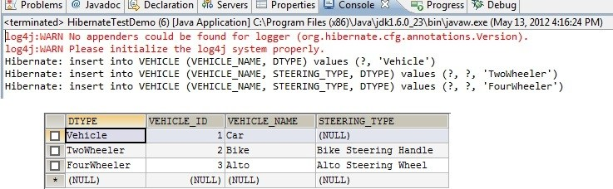
In the above table Vehicle there are four columns (DTYPE, VEHICLE_ID, VEHICLE_NAME, STEERING_TYPE). The first column has the value of discriminator type(DTYPE) is Vehicle, TwoWheeler, FourWheeler as its entity name by default.

Slide 30
With Table Per Class Strategy
In this case every entity class has its own table i.e. table per class. The data for Vehicle is duplicated in both the tables. This strategy is not popular and also have been made optional in Java Persistence API. Advantage:
Possible to define NOT NULL constraints on the table.
Disadvantage:
Tables are not normalized.
To support polymorphism either container has to do multiple trips to database or use SQL UNION kind of feature.
In this case there no need for the discriminator column because all entity has own table.

Slide 31
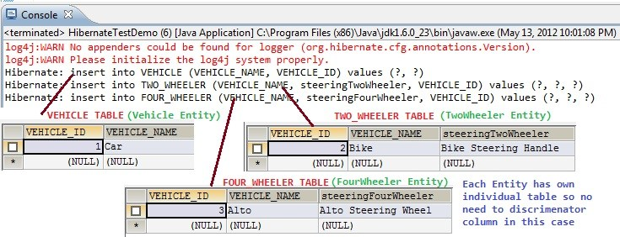

Slide 32
Table Per Subclass (Joined Strategy)
It’s highly normalized but performance is not good.
Advantage:
Tables are normalized.
Able to define NOT NULL constraint.
Disadvantage:
Does not perform as well as SINGLE_TABLE strategy

Slide 33
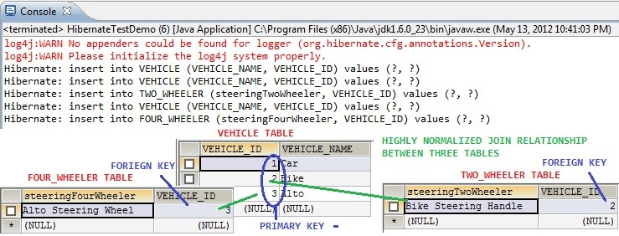

Slide 34
Criteria | Single Table | Table per subclass(Join Strategy) | Table per Class
Table Support | Data not normalized. Constraint for mandatory columns to be not nullable cannot applied. Change in any subclass leads to change in structure of Table | Normalized. Mandatory column constraint can be applied | One table for each concrete class. Not maintainable. Change in base class leads to changes in all tables of derived class

Slide 35
Discriminator Column | Present | Absent | Absent
Retrieving data | simple SELECT. All data is in one table. Using discriminator type, individual types can be selected | Joins among table. For example fetching FourWheeler will require a join on FourWheeler and Vehicle table. If all user needs to be fetched than it will put a join for all three tables | Separate Select or Union Select

Slide 36
Updating and Inserting | Single INSERT or UPDATE | Multiple. For Vehicle type one insert on Vehicle table. For FourWheeler type one insert on Vehicle table and another on FourWheeler table. | One insert or update for each subclass
JPA Support | Mandatory | Optional

